Slide 1
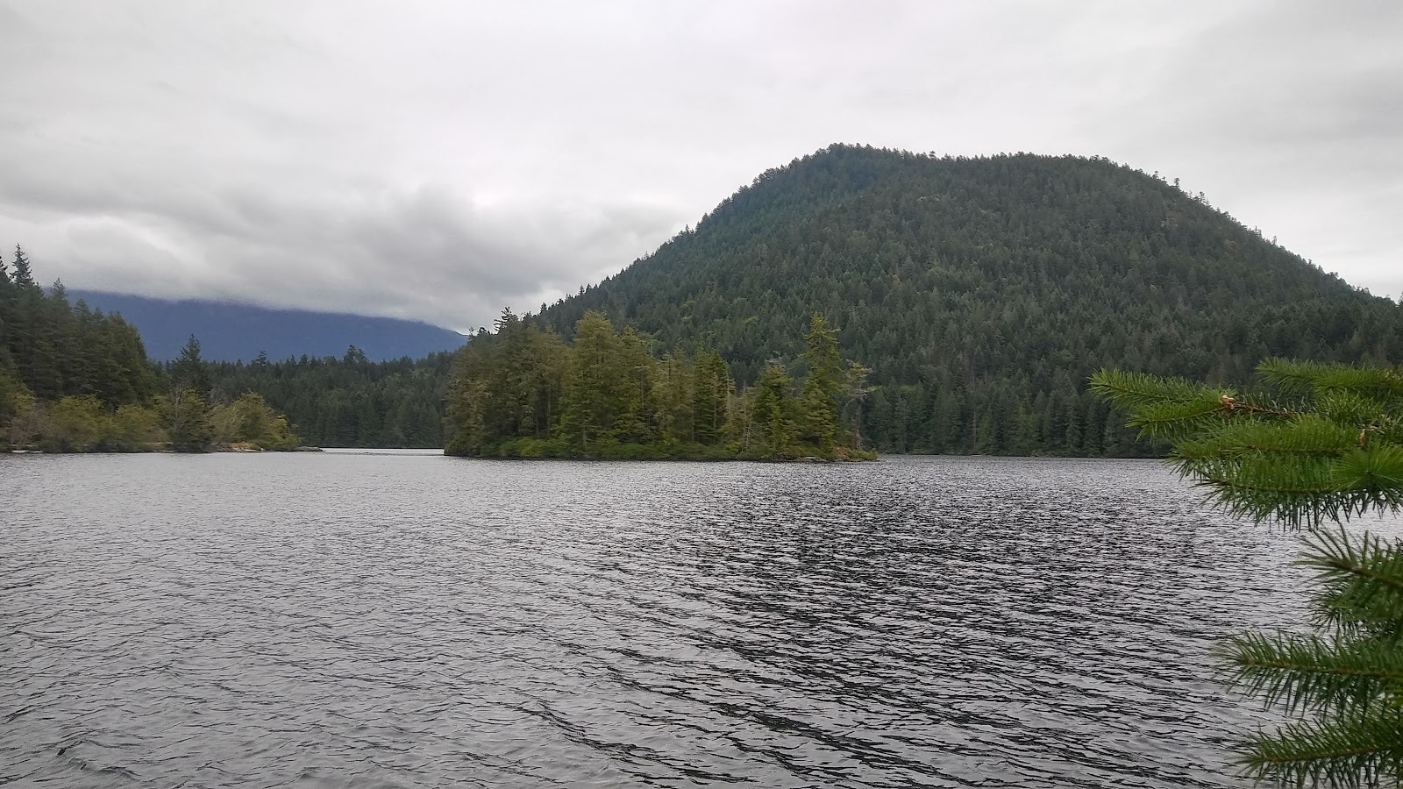








Predicting the presence of a hypolimnetic zone and whether it is hypoxic at large spatial scales
Richard LaBrie & Roxane Maranger
SS58 Shallow Lakes: Ecology, Biogeochemistry, and Human Health

Slide 2
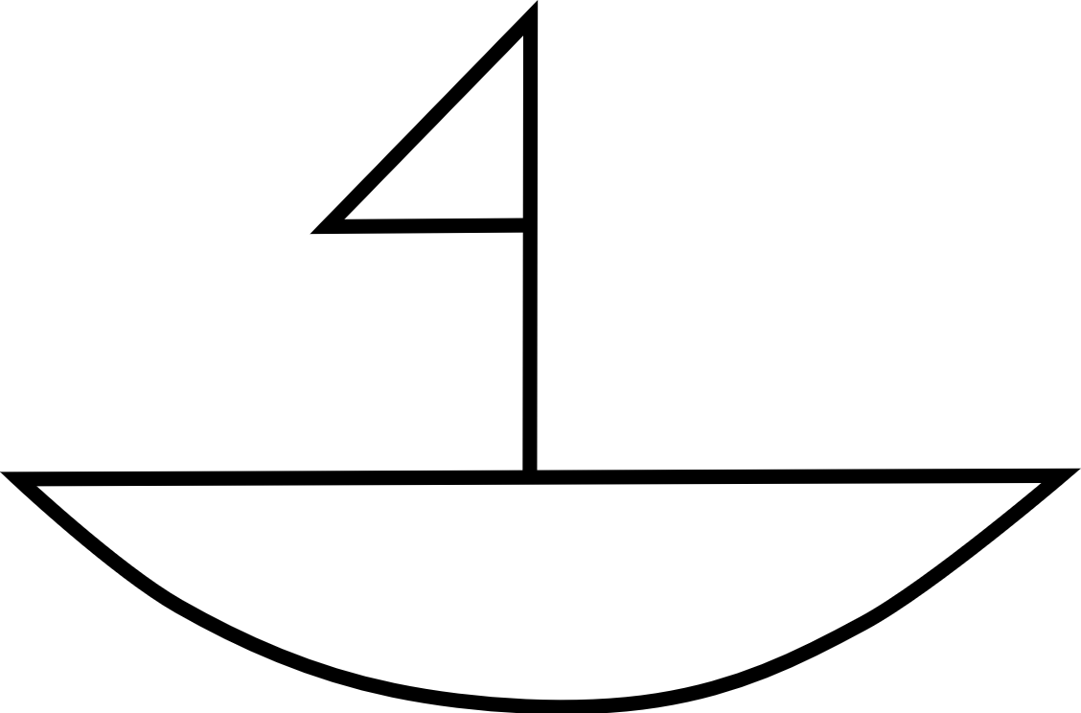
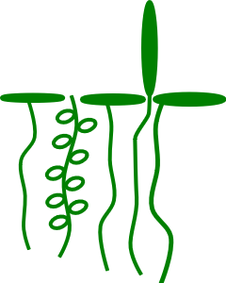
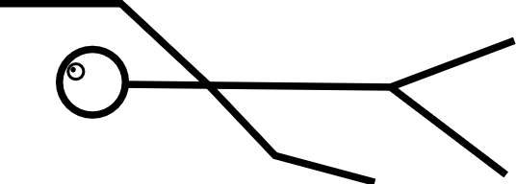
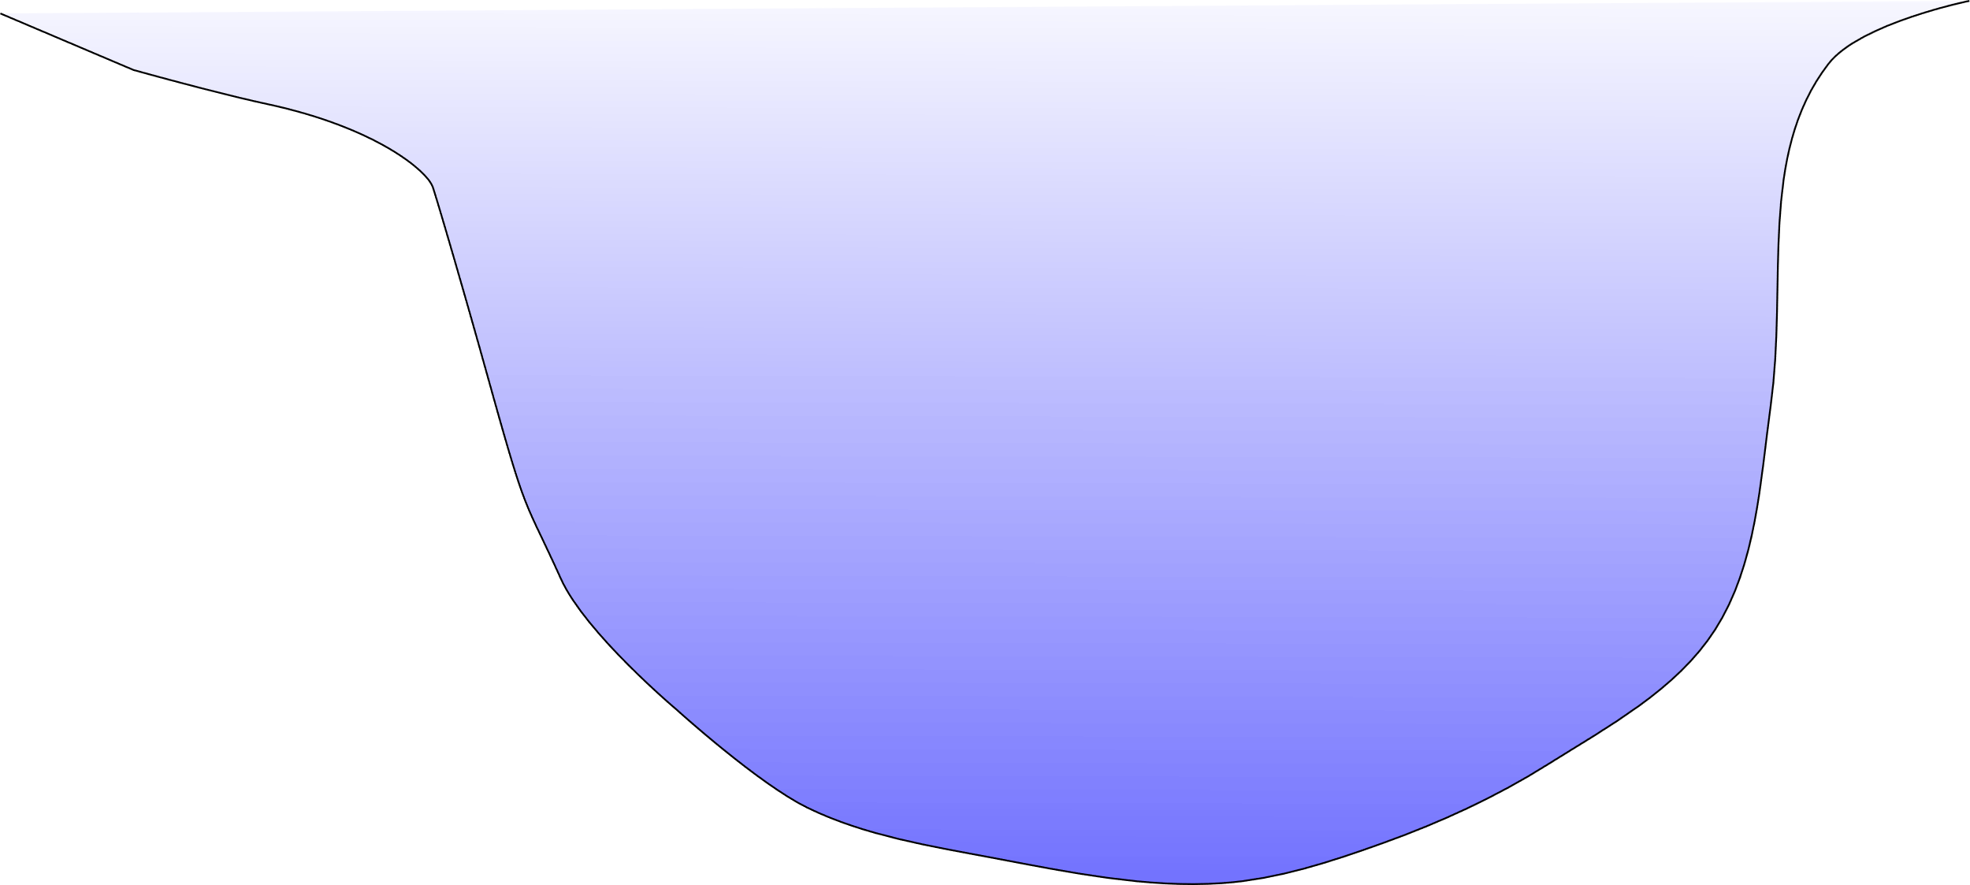
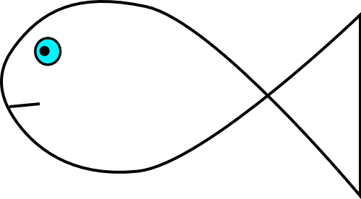
Ecosystem services
Notes:
Lakes worlwide provide valuable ecosystem services like drinking water, recreational opportunities, storage of phytoplankton biomass and external inputs from the watershed. And they also provide habitats for many différents species.

Slide 3
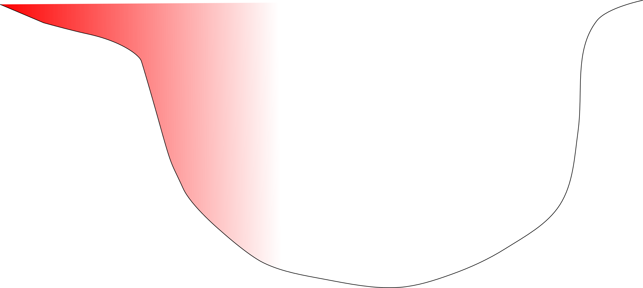
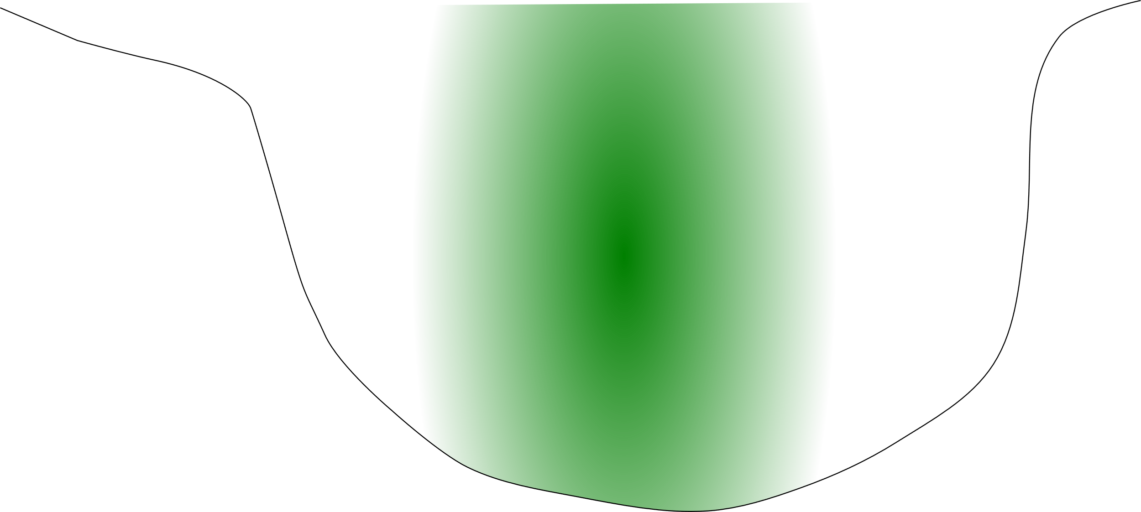
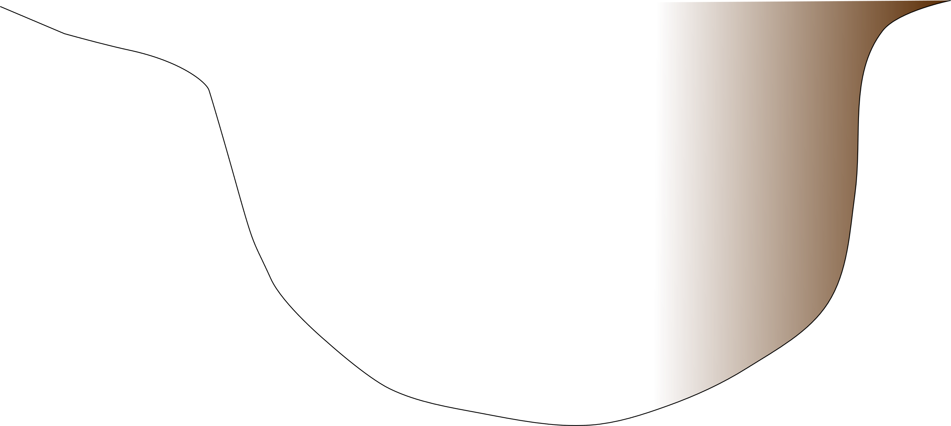
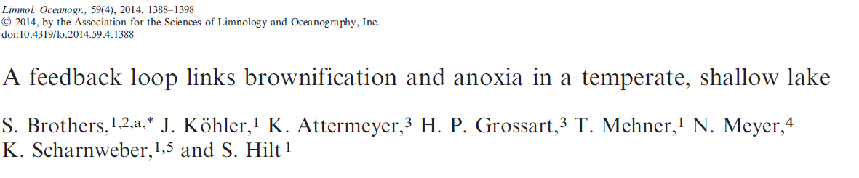
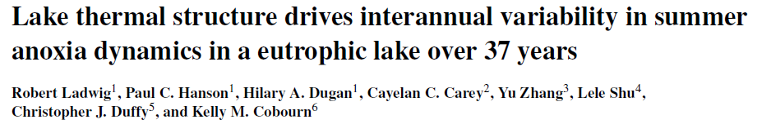
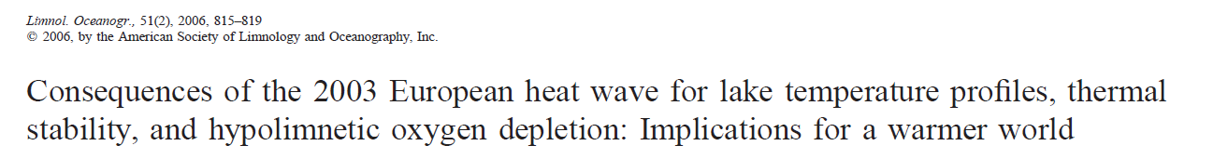
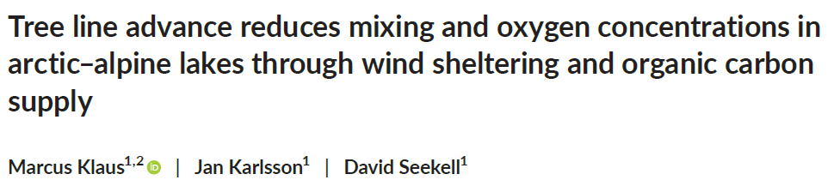
Human pressures on lakes
Climate change(T°)
Eutrophication (N-P)
Browning (DOC)
Limnology and Oceanography, 2014
Hydrology and earth system sciences, 2021
Epi-
Limnology and Oceanography, 2006
Meta-
Jankowski, Livingstone et al.
Global Change Biology, 2021
O₂
Hypolimnion
Notes:
But several of these ecosystem services require the presence of a cool, oxygenated hypolimnion. However, global and regional scales human pressures like Climate change, Eutrophication and Browning may alter the ability of a lake to provide these services by creating episodic or prolonged periods of hypoxia.

Slide 4
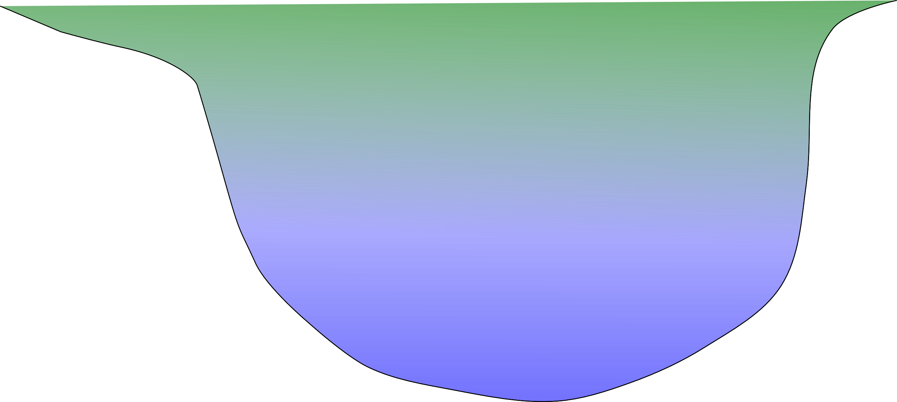
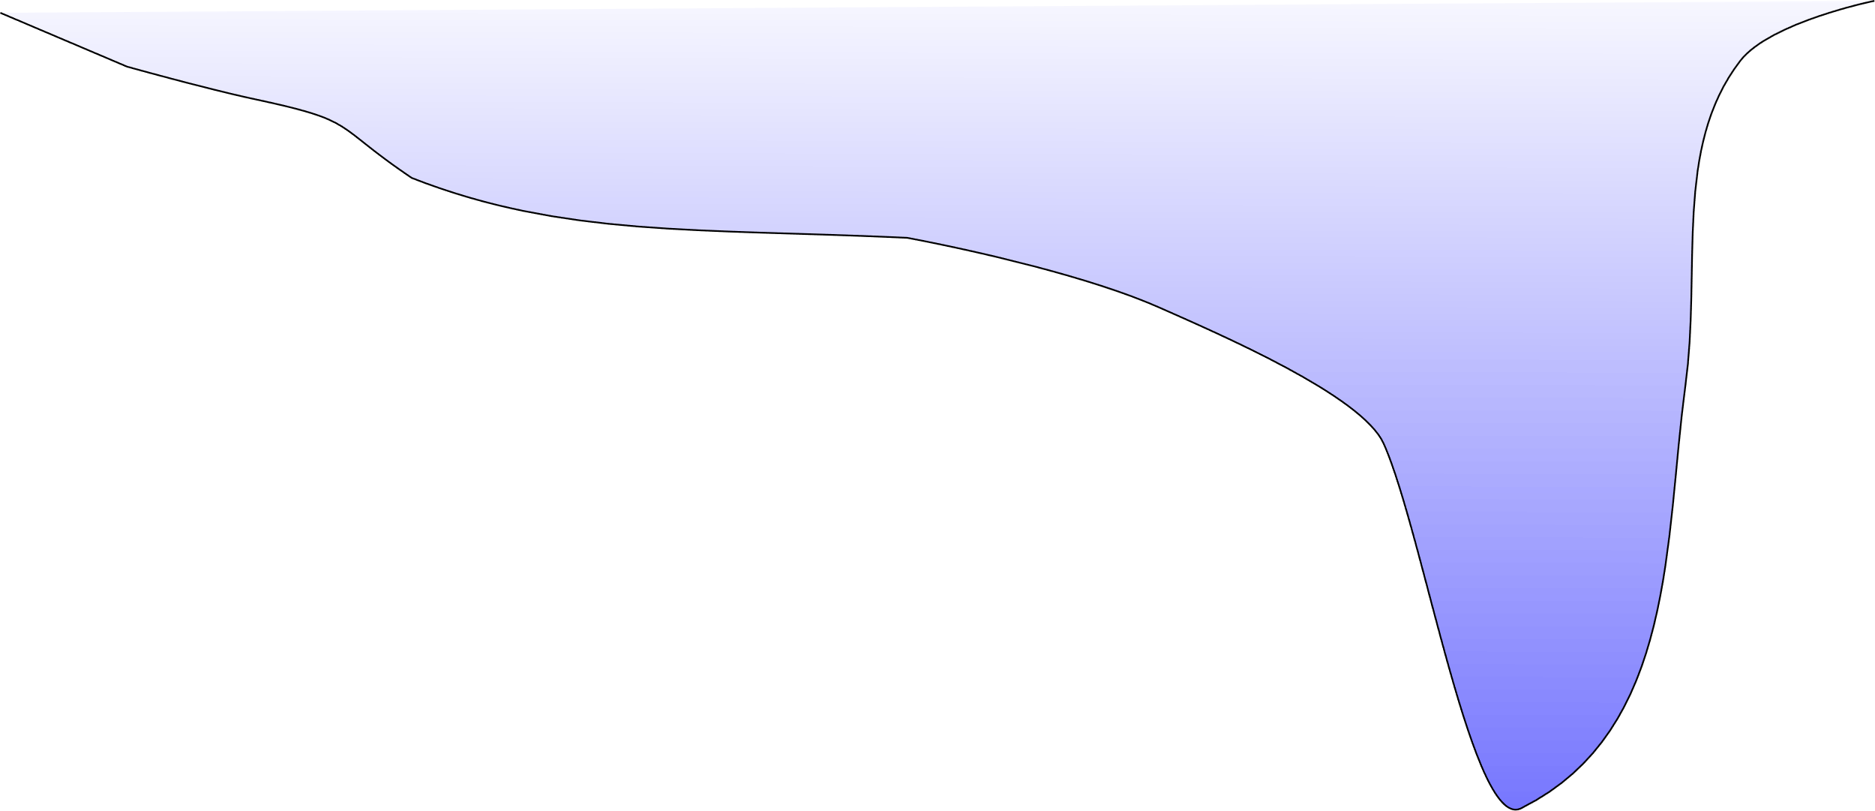
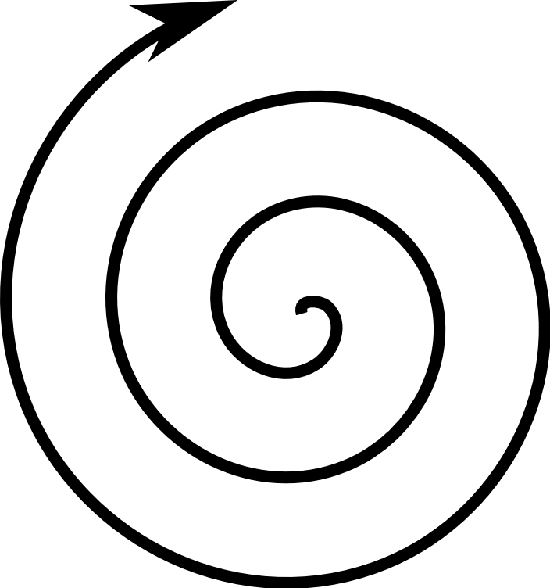
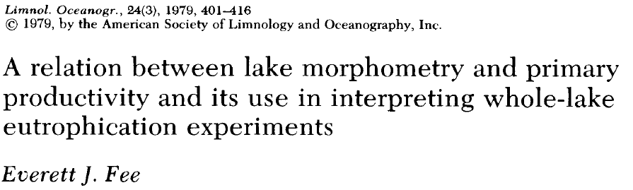
Regulating influence of morphometry
Resilience --
Resilience -
Resilience ++
Notes:
These human pressures are modulated by the lake’s morphometry. Small lakes will become green and brown more easily; shallow lakes with an extended littoral zone will amplify these pressures by recirculating nutrients from the sediments into the water column, and big, deep lakes will sustain much more inputs before their trophic state changes.

Slide 5
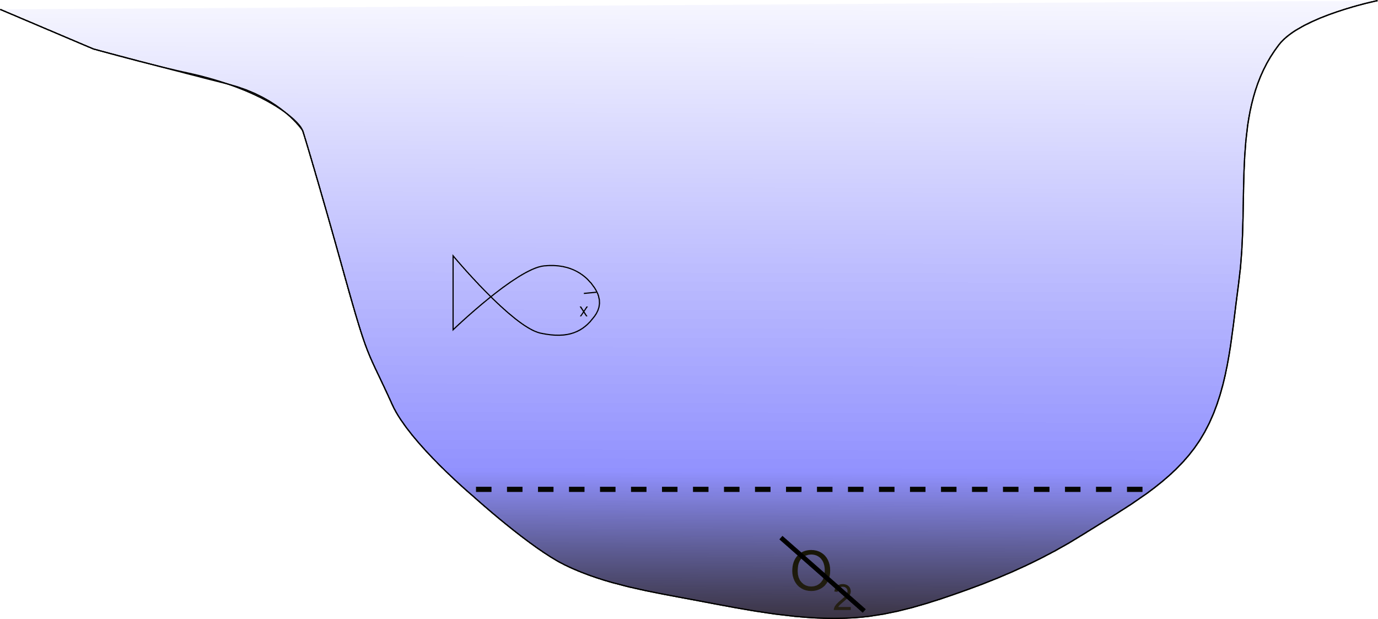
Consequences of hypoxia
Loss of habitats
CH₄ and N₂O production
Phosphorus release
Metal toxicity
P release

Slide 6
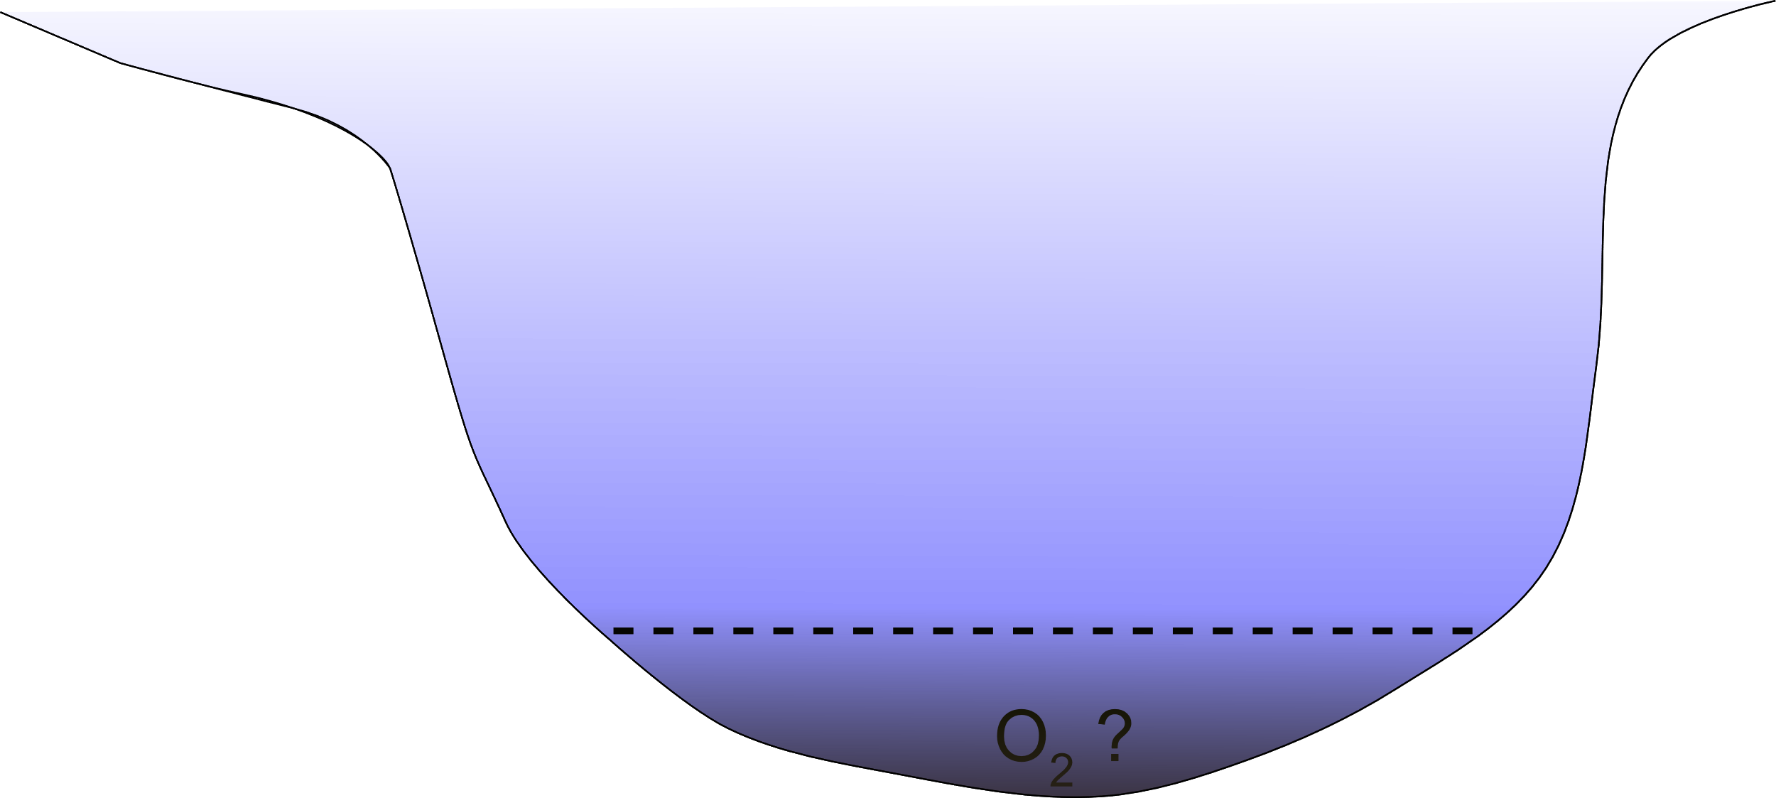
What determines the presence of an hypolimion and hypoxia at large spatial scales
Notes:
In this study, we explored the influence of morphometry and lake characteristics to better understand what determines the presence of an hypolimnion and hypoxia at large spatial scales

Slide 7
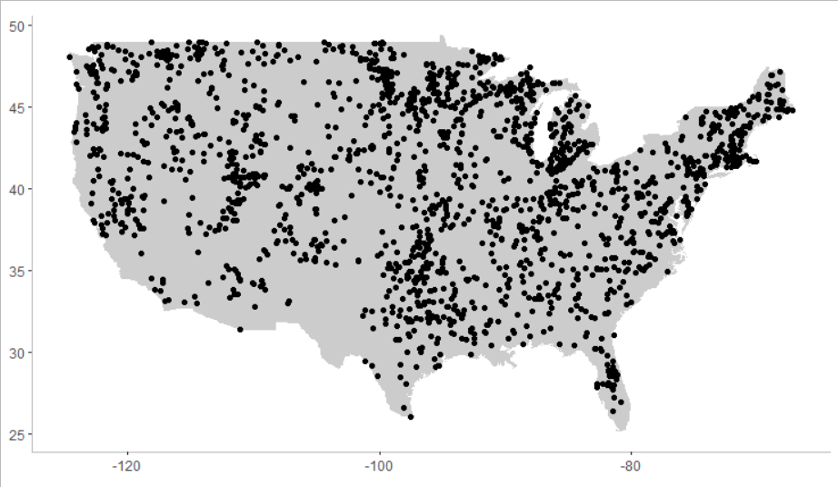
Methods: NLA 2007 and 2012
Notes:
To do so, we worked the National Lake Assesment 2007 and 2012 in the US. We only selected cold lakes, that is those of more than 40° of latitudes after correcting for altitude

Slide 8
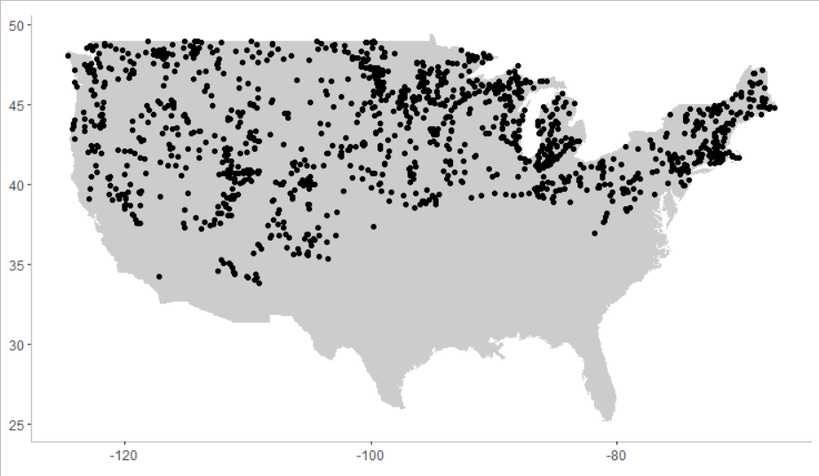
All lakes >40° latitude corrected for altitude
Notes:
And selected lakes that were at least 2 meters deep

Slide 9
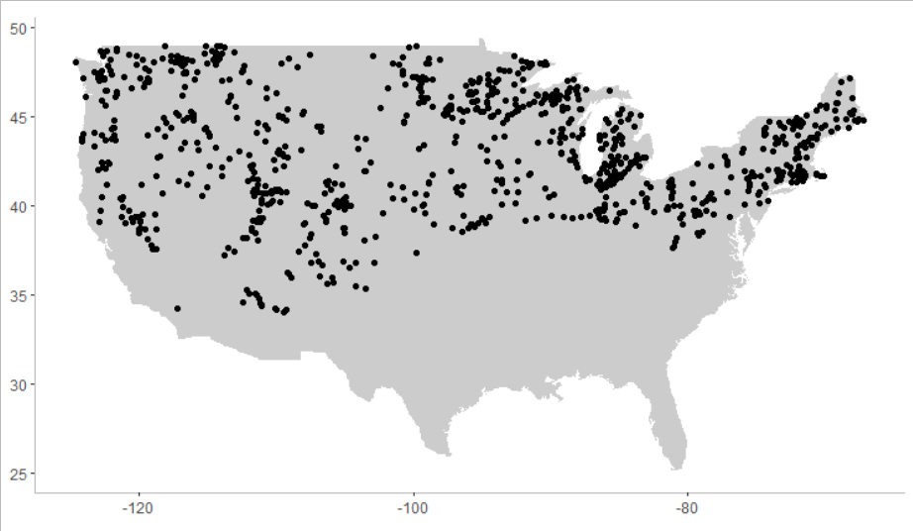
That are deeper than 3m (1243 lakes)
Notes:
to have enough vertical resolution to be able to detect an hypolimnion and because they can be seasonally stratified. 1250 lakes satified these criteria

Slide 10
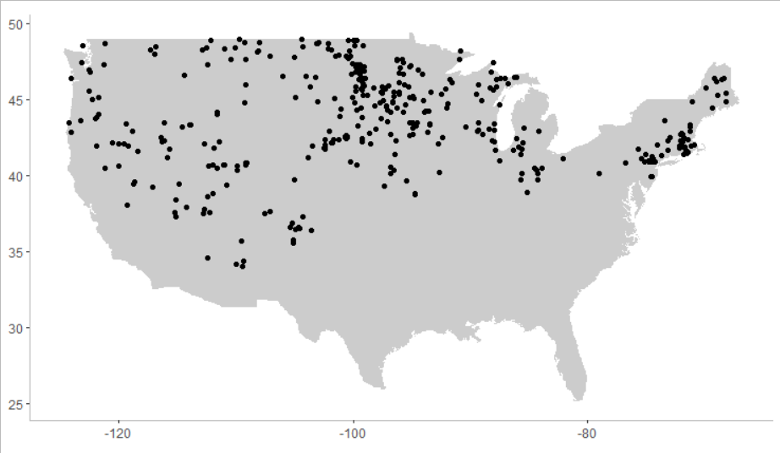
That are shallower than 3m (495 lakes)

Slide 11
Methods
Basic morphometric, limnological and geographical characteristics of 1230 lakes
Random Forest of 1000 trees with repeated k-fold cross validation
Sensitivity analysis
1. Can we predict the presence of an hypolimnion?
2. Can we predict the presence of hypoxia in lake with an hypolimnion?
3. Can we predict the presence of hypoxia in shallow lakes?

Slide 12

Predicting the presence of an hypolimnion
Overall accuracy of the forest: 84.5%
Legend
Nr lakes
(% of lakes)
552 (48.9%)
75 (6.6%)
100 (8.9%)
401 (35.6%)
Notes:
For our first question, the overall accuracy of the random forest was 85%, divided as such. On the main diagonal, in green, we have the number of lakes and their proportion that were correctly assigned by the radom forest. The other diagonal, in red, is where the random forest assigned the lakes to the wrong category. Let see if there is a spatial pattern

Slide 13
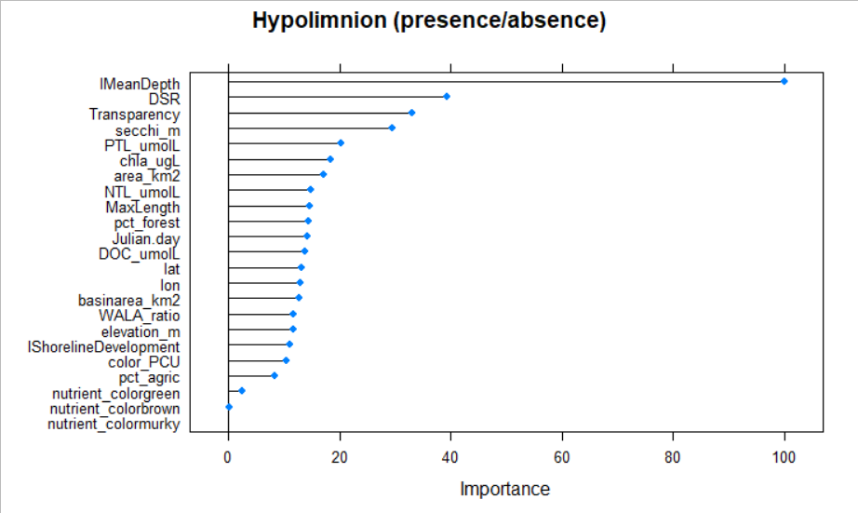
Hypolimnion is driven by morphology and water transparency
DSR
Bowl
Plate
Notes:
These are the most important variables in the random forest. The X-axis gives the relative importance of these variables compared to the main one, Average depth.
Deeper lakes have a higher probability of developing a hypolimnion. If we look at the next three variable, we have the dynamic sediment ratio, which gives a general idea of the lake shape. In order for a hypolimnion to develop, the lake should look more like a bowl than a plate. And we have water transparency, the deeper the secchi depth is, the more likely there will be an hypolimnion.

Slide 14
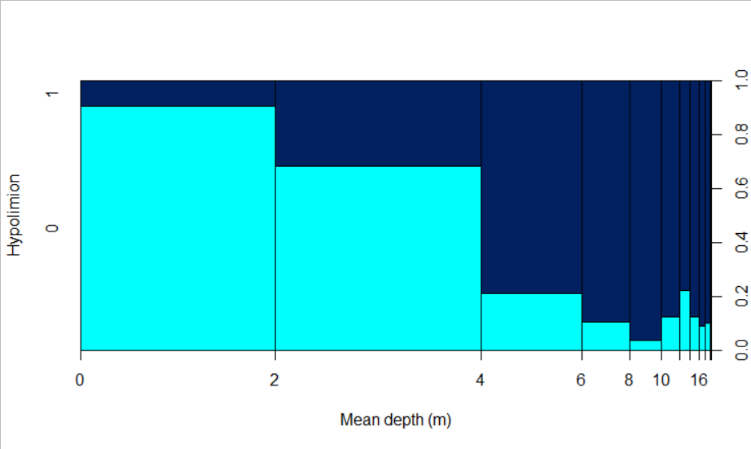
Deeper lakes have a higher probability to develop a hypolimnion
Legend
1
Bar’s width: number of lake in the group
Yes
0.8
0.6
Lakes with or without hypolimnion (%)
No
0.4
0.2
0
Notes:
Here we see in dark gray lakes that do not have an hypolimnion and in light gray, those that have one, grouped by their mean depth. Lakes with an average depth of at least 4m have 80% or more chances to develop an hypolimnion.

Slide 15
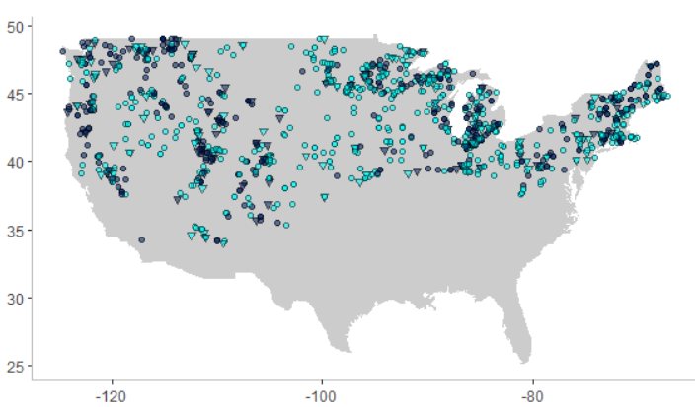
No spatial pattern
No hypolimnion
Hypolimnion
Correct prediction
Incorrect prediction
Notes:
Here are all the lakes, with the same color-code as before and the shapes represent the absence or presence of an hypolimnion. For example, a green circle is a lake that was correctly predicted to have an hypolimnion. There is no spatial pattern in the US, but what drives the random forest?

Slide 16

Predicting hypoxic condition
Overall precision of the forest: 80.6%
Legend
Nr lakes
(% of lakes)
118 (23.6%)
56 (11.2%)
41 (8.2%)
285 (57.0%)
Notes:
Now looking at hypoxia, the random forest had an overall accuracy of 82%, with a good prediction for nearly 400 lakes.

Slide 17
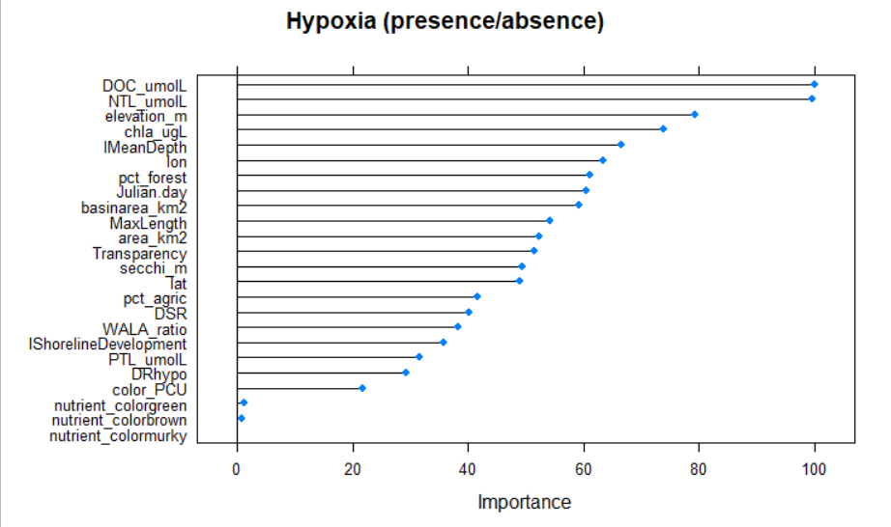
Hypoxia is driven by productivity
Notes:
Longitude is only the seventh most useful variable in the random forest. In the conterminous USA, hypoxia is mostly driven by lake productivity, with a significant influence of the mean depth, elevation and the day of the year.

Slide 18
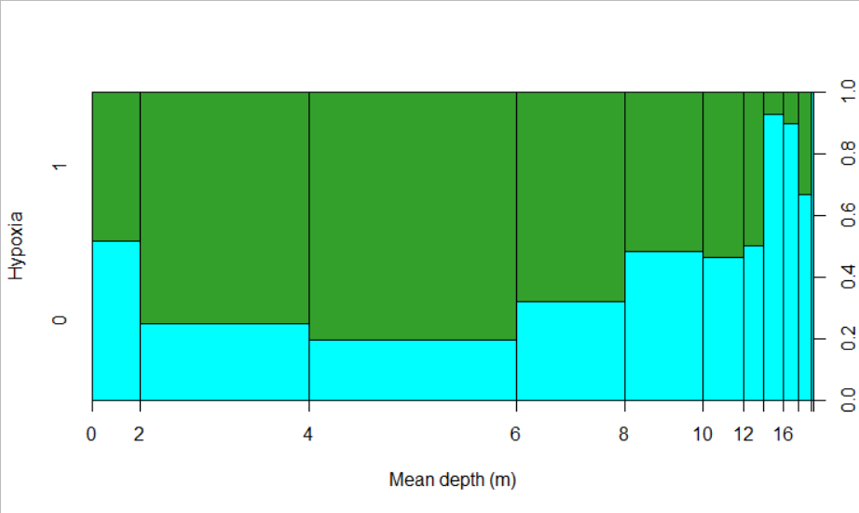
Shallower lakes are more prone to hypoxia
Legend
1
Bar’s width: number of lake in the group
0.8
Yes
0.6
Lakes with or without hypoxia (%)
0.4
No
0.2
0
Notes:
In contrast to the presence of an hypolimnion, shallower lakes have a higher probability of developping hypoxia than deeper lakes.. In the next slides, we will explore the random forest by modifying the three productivity metrics that were the most important in the random forest, and look at how this changes hypoxia

Slide 19
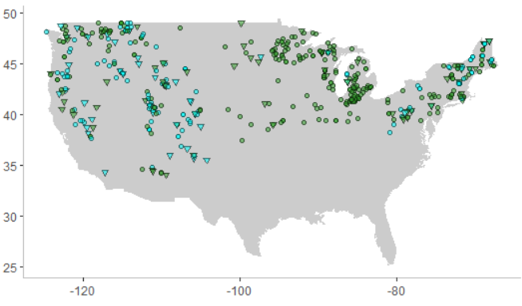
East-West spatial pattern
Incorrect prediction
Correct prediction
No hypoxia
Hypoxia
Notes:
By mapping these results, we see a east-west spatial partern, with most lakes developping hypoxia in the mid-east and near the great lakes, and more lakes without hypoxia in the mid-west. So let see what other variables than longitude predict hypoxia

Slide 20
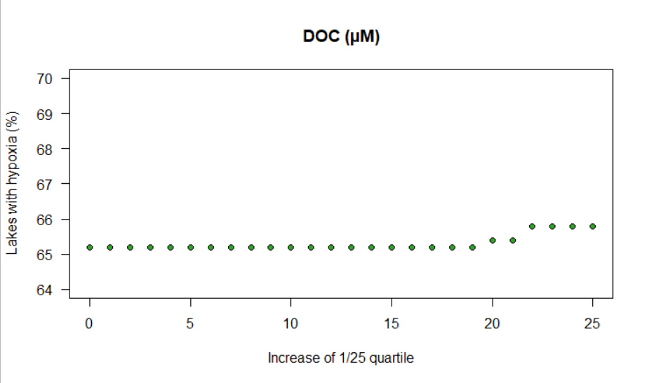
Exploring the forest: sensitivity analysis
20
Notes:
All plots will be constructed as such: The Y-axis is the proportion of lakes with hypoxia, the X-axis represents an increase of 1 percentile of the variable in the title, in this case DOC, so that after 25 increase on the far right of the graph, all values have increased by the first quartile. For DOC, TN and Chlorophyll, we do not see much increase even though they are the most important variables. But when we look at their combined influence, the proportion of hypoxia starts to increase, and get high with an increase in both DOC and TN. When we look at all 3 together

Slide 21
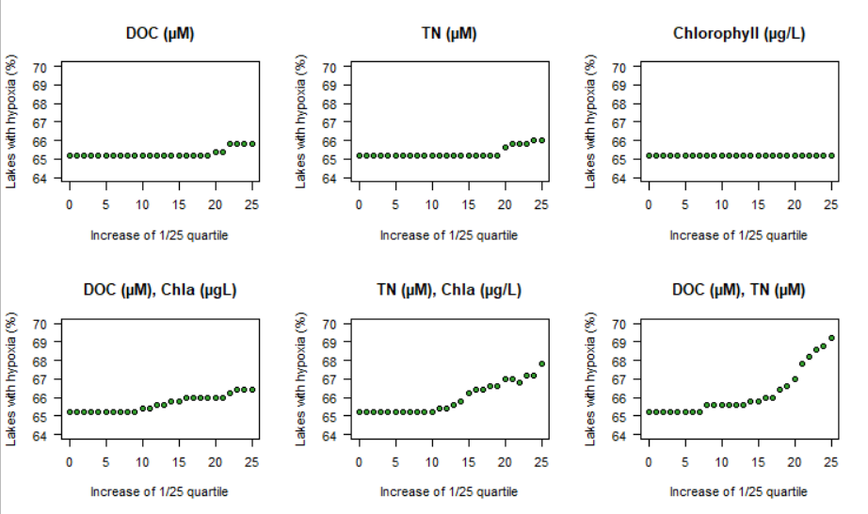
Exploring the forest: sensitivity analysis
First quartile is
DOC: 212.52µM (2.55 mg/L)
TN: 12.9 µM (180.75 µg/L)
Chla: 1.46 µg/L
Notes:
All plots will be constructed as such: The Y-axis is the proportion of lakes with hypoxia, the X-axis represents an increase of 1 percentile of the variable in the title, in this case DOC, so that after 25 increase on the far right of the graph, all values have increased by the first quartile. For DOC, TN and Chlorophyll, we do not see much increase even though they are the most important variables. But when we look at their combined influence, the proportion of hypoxia starts to increase, and get high with an increase in both DOC and TN. When we look at all 3 together

Slide 22
Exploring the forest: sensitivity analysis
First quartile is
DOC: 212.52µM (2.55 mg/L)
TN: 12.9 µM (180.75 µg/L)
Chla: 1.46 µg/L
Notes:
All plots will be constructed as such: The Y-axis is the proportion of lakes with hypoxia, the X-axis represents an increase of 1 percentile of the variable in the title, in this case DOC, so that after 25 increase on the far right of the graph, all values have increased by the first quartile. For DOC, TN and Chlorophyll, we do not see much increase even though they are the most important variables. But when we look at their combined influence, the proportion of hypoxia starts to increase, and get high with an increase in both DOC and TN. When we look at all 3 together

Slide 23
Exploring the forest: sensitivity analysis
First quartile is
DOC: 212.52µM (2.55 mg/L)
TN: 12.9 µM (180.75 µg/L)
Chla: 1.46 µg/L
Notes:
All plots will be constructed as such: The Y-axis is the proportion of lakes with hypoxia, the X-axis represents an increase of 1 percentile of the variable in the title, in this case DOC, so that after 25 increase on the far right of the graph, all values have increased by the first quartile. For DOC, TN and Chlorophyll, we do not see much increase even though they are the most important variables. But when we look at their combined influence, the proportion of hypoxia starts to increase, and get high with an increase in both DOC and TN. When we look at all 3 together

Slide 24
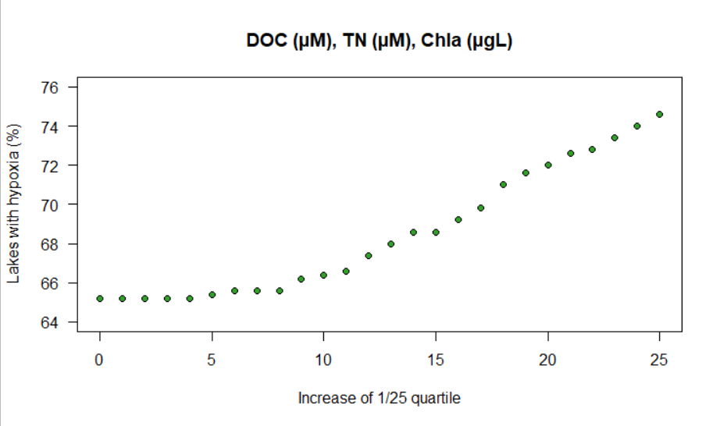
Synergistic effect of the three major contributors
47 lakes
~10%
First quartile is
DOC: 212.52µM (2.55 mg/L)
TN: 12.9 µM (180.75 µg/L)
Chla: 1.46 µg/L
Notes:
The proportion of lakes with an hypolimnion that develops hypoxia increased by 11%, and if we look at these changes as a function of mean depth

Slide 25
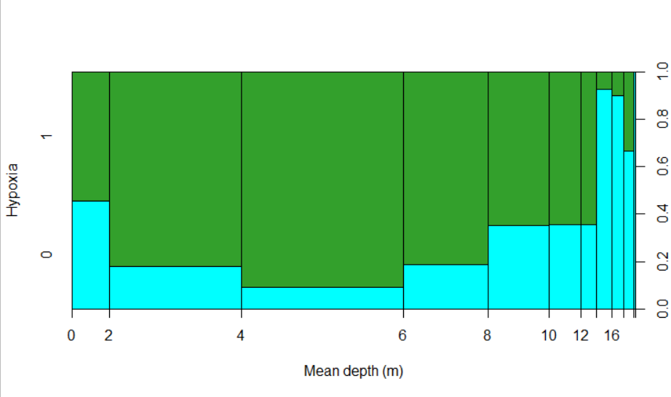
Distribution of hypoxia as a function of mean depth
1
Original data
0.8
0.6
Lakes with or without hypoxia (%)
0.4
0.2
0
Notes:
90% of lakes between 2 and 6 meters of mean depth would develop hypoxia

Slide 26
Predicting hypoxic condition in shallow lakes
Overall precision of the forest: 87% !
Legend
Nr lakes
(% of lakes)
388 (87.4%)
56 (12.6%)
0 (0%)
0 (0%)
Notes:
Now looking at hypoxia, the random forest had an overall accuracy of 82%, with a good prediction for nearly 400 lakes.

Slide 27
NLA methodology
O₂ ?

Slide 28
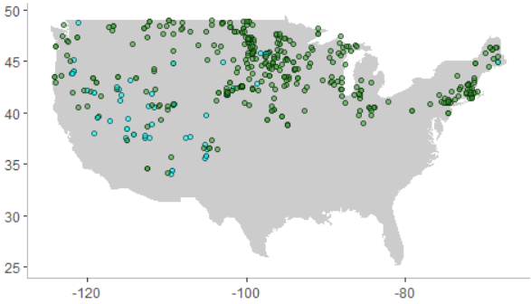
88% of shallow lakes could develop hypoxia
No hypoxia
Hypoxia
Notes:
And most of the shallow lakes that are « protected » from hypoxia are high altitude lakes

Slide 29
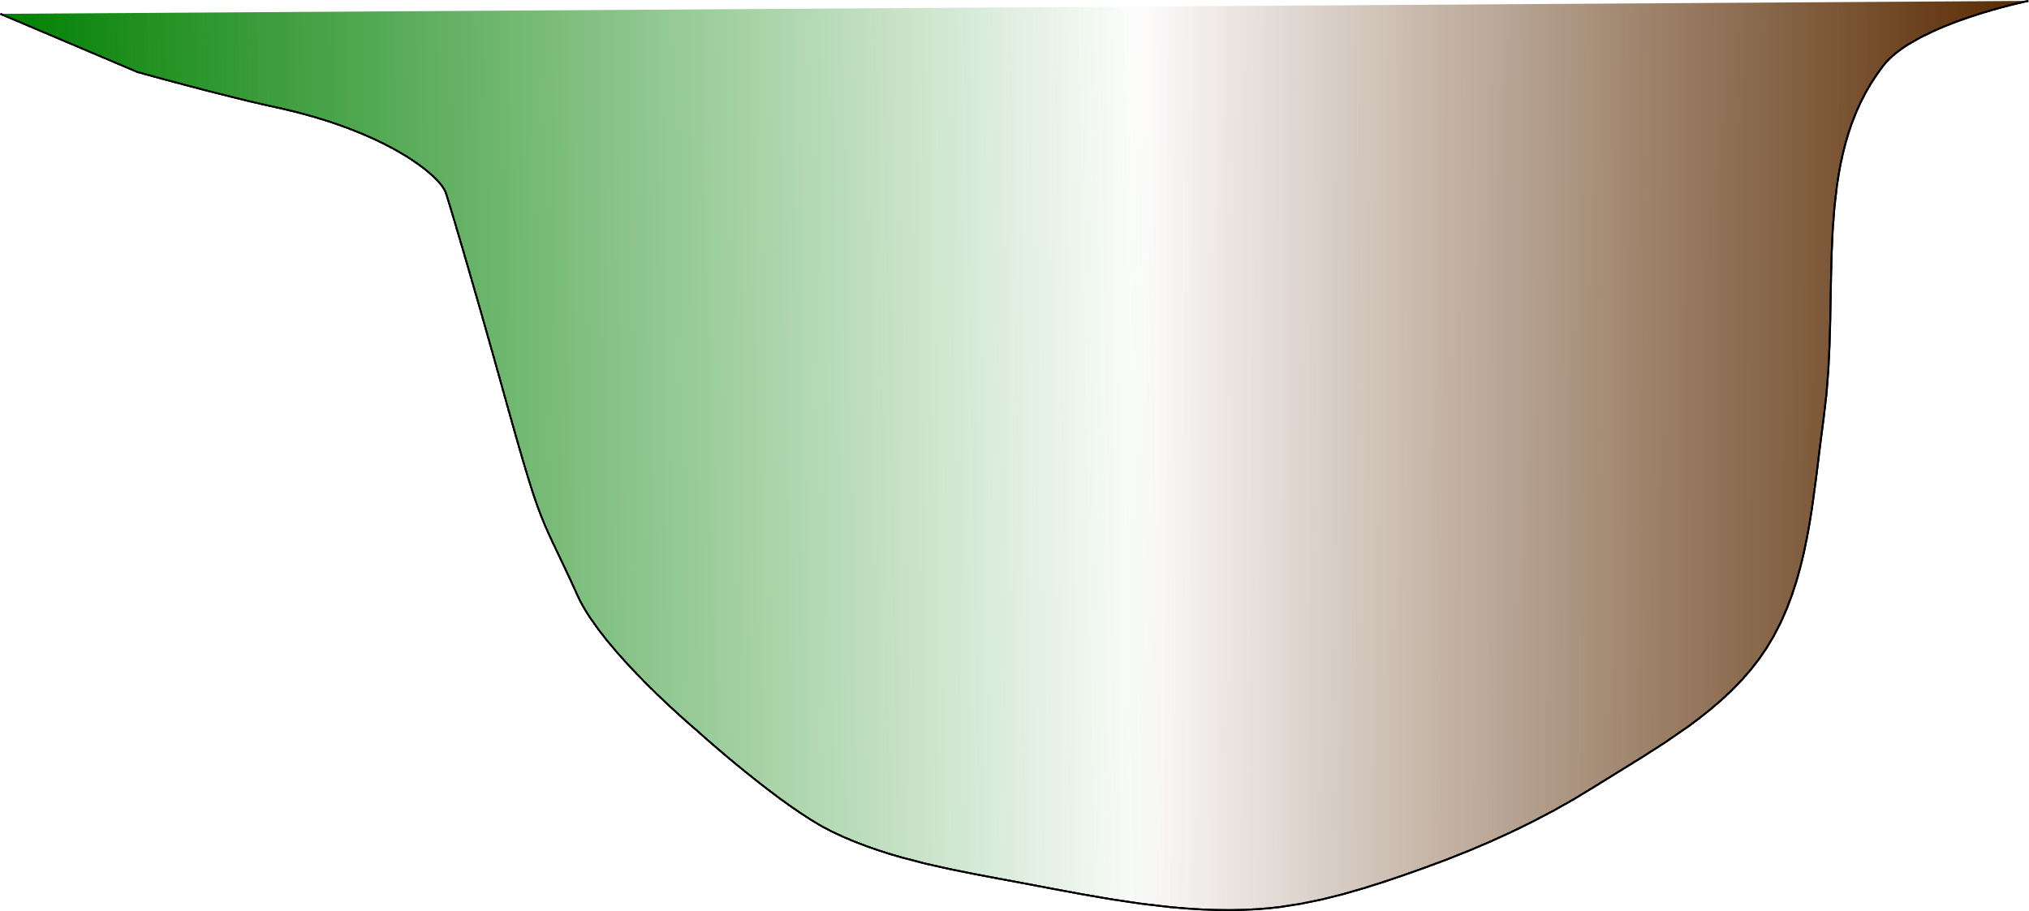
Take home
Mean depth is the strongest predictor for the presence of an hypolimnion, followed by lake’s shape
No hypolimnion
Hypolimnion
browning
greening
Lake productivity (C, N) drives hypoxia
O₂
Shallow lakes (2–6 m) are more prone to hypoxia
O₂
O₂

Slide 30
Acknowledgements
Nicolas Fortin St-Gelais
Lab colleagues
Photo credits: Andréanne Dupont
Funding sources
Mitacs
FRQNT
NSERC

